Slide 1





JUNE 2025
SOCIAL MEDIA MARKETING PLAN
DMV AMAZON CONSULTING
ARUNIMA BOLLAMPALLY
MBA-Analytics,
Hult International Business School-Boston,MA
Notes:
Hello everyone, this is team 6, and today we'll walk you through the social media mkt plan for DMV amazon consulting

Slide 2




About Us
Tax Filing & Accounting
DMV Amazon Consulting is a multi-service firm based in Silver Spring, Maryland, providing trusted, affordable support in differet business areas.
Immigration Consulting (Non-legal)
Business Support for Immigrant Entrepreneurs
Travel Bookings & Notary Services
Notes:
DMV Amazon Consulting is a trusted multi-service firm based in Silver Spring, Maryland.
the company specializes in tax filing, immigration consulting, travel services, and small business support
all tailored for immigrant communities, especially the Ethiopian.
Its approach is personal, accessible, and built around cultural understanding.

Slide 3



Industry Environment
MARKET TRENDS
GROWTH OPPORTUNITIES
CUSTOMER PAIN POINTS
Rising demand for multilingual, immigrant-friendly services
Growth of tax/immigration platforms (but lacking human touch)
Increased digital behavior among younger immigrants
Position as a digital-first, culturally empathetic brand
Capture younger audiences via social media, TikTok, and email
Use CRM/email automation for client retention
Expand reach with multilingual marketing
Confusion around U.S. tax and immigration paperwork
Mistrust in generic online services
Fear of errors or legal issues
Over-reliance on word of mouth
Notes:
the company operates in a market where demand is rising fast — particularly for bilingual, immigrants
But here’s the gap: most digital tools today are cold, and lacking human touch.
That’s where the company stands out — they have the heart, but now they need to grow the digital muscle.

Slide 4



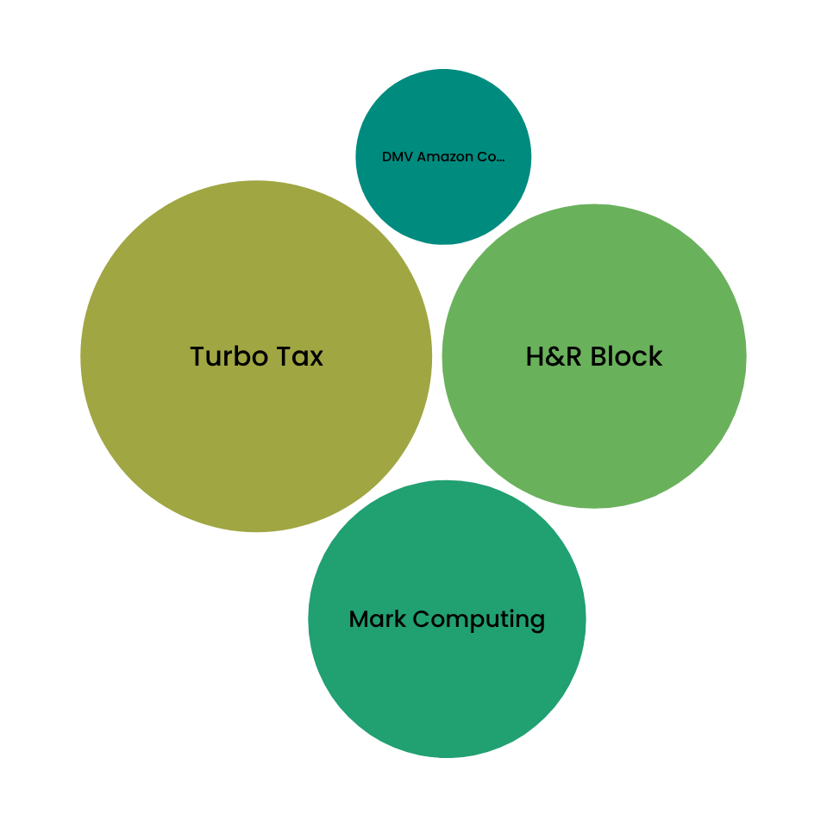



Competitor Analysis
DMV Amazon Consulting operates in a competitive space alongside national leaders like TurboTax and H&R Block, as well as local firms such as Mark Computing. While these competitors dominate in market size, digital infrastructure, and brand visibility, DMV differentiates itself through culturally-rooted, bilingual services tailored to the Ethiopian community in the DMV area. By enhancing its digital marketing and targeting younger, multicultural audiences, DMV can position itself as a trusted, community-first alternative in a largely impersonal market.
Market Leader Board
DMV Amazon Consulting
vs.
competitors
What are the competitors doing that we are not doing?
Strong online presence
Abundant online tools & resources
Consistent customer engagement
Notes:
Looking at competitors like TurboTax and H&R Block, they dominate online, but they lack cultural empathy.
DMV amazon's unique advantage is the connection to the community, but they must improve the online presence, tools, and consistent engagement to truly compete.

Slide 5




Digital Presence - Key Findings
GOOGLE RANKING
UI/UX
SOCIAL MEDIA
WEBSITE
LOW visibility for key terms like “immigration help Silver Spring”
DO NOT APPEAR for most relevant searches
Weak SEO
BROKEN WhatsApp link
LACKS visual appeal & engagement tools
Inactive since 2022
NO official business page (facebook & Instagram)
Outdated design and slow load time (4.2s)
NO meta descriptions or clear CTAs
Notes:
As we can see, the brand faces low Google visibility, an inactive social presence, and an outdated website experience.
That means missed opportunities, especially among younger, mobile-first users.

Slide 6



MAIN BRAND GOALS
Build brand visibility and awareness
01
Attract new customers and retain current ones
02
Notes:
We have 2 brand goals
first is to build brand visibility & awareness
and 2nd is to retain new customers and retain existing ones

Slide 7
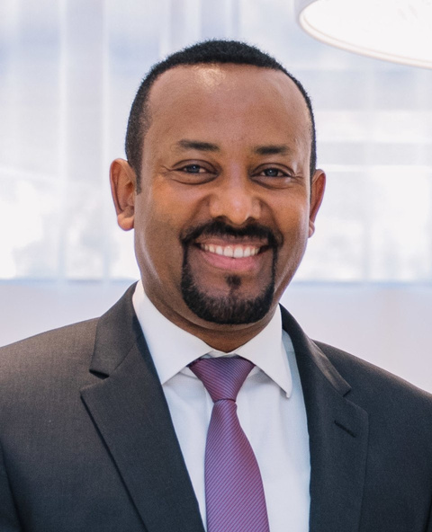
INTERESTS | Business growth and franchising opportunities Supporting other Ethiopian-owned businesses
HOBBIES | Cooking traditional Ethiopian dishes watching soccer (EPL)
NEEDS | Reliable tax and bookkeeping services Help with payroll and employee benefits
PAIN POINTS | Missed deadlines in the past due to unclear tax obligations Needs a one-stop shop for business and personal services
GOALS | Scale his restaurant to a third location Stay compliant with IRS and state filings
MOTIVATION | Provide jobs and good food to the community Be seen as a trusted, professional business owner
FRUSTRATION | Feeling lost with IRS rules and forms Getting “generic” service from large consulting firms
BUSINESSMAN BINYAM
NAME
Binyam Kebede
AGE
44
LOCATION
Takoma Park, MD
OCCUPATION
Restaurant Owner
MARITAL STATUS
Yes
KIDS
No
ANNUAL INCOME
$70.000
Notes:
One of the personas that we developed is our B2B Persona - Businessman Binyam
Binyam is a restaurant owner who is interested in growing his business and supporting ethiopian owned businesses.
One of the pain points we identified is that he often misses tax deadline due to confusion in filing documents and ultimately he needs a one stop shop for supporting his business needs

Slide 8

FREELANCER FREDA
INTERESTS | Sharing “day in my life” content as a student Late-night YouTube rabbit holes (vlogs, study tips, immigration updates)
HOBBIES | Shooting content for Tiktok Going to the gym
NEEDS | Step-by-step guidance for staying in status (OPT, CPT, extensions) Affordable help filing visa-related forms (change of status, I-20 issues)
PAIN POINTS | Needs help interpreting Form I-539 and other USCIS forms Her student visa is expiring soon, and she doesn’t want to lose status
GOALS | Secure work authorization after graduation (OPT) Eventually transition to permanent residency
MOTIVATION | Immigration status equals security and future career opportunities She wants to support her family financially and emotionally
FRUSTRATION | USCIS portals are confusing and stressful Forms are hard to understand — she’s scared of “messing it up”
NAME
Freda Gonzalez
AGE
25
LOCATION
Silver Spring, MD
OCCUPATION
Int’l Student | Freelance Editor
MARITAL STATUS
Single
KIDS
No
ANNUAL INCOME
$45,000
Notes:
our 2nd persona is our B2C Freelancer Freda. Freda is an intl student who is currrently seeking help for visa preparation and filing.
Her visa would expire soon so sh e needs to get her paperwork done or else she will lose her status.

Slide 9


































Customer Journey
Map
Awareness
Consideration
Convert
Loyalty
Advocacy
Hear from other business owners or see flyer
Schedule an appointment, phone call,
in-person meeting, email with a document
Call to requests pricing, comparing quotes & read reviews
Use the service regularly and asks questions
Refers to other people or businesses
Channels
sub-mission
Phonecall
Commu-nity
Word of mouth
Word of mouth
Fliers
Web
search
Email
Social Media
Phonecall
Whatsapp
Whatsapp
Community referal
Experience
Curious but skeptical
Interested
Comfortable
Frustrated if late
Loyal
Does not know if it’s legitimate or affordable with the lack of online precense
Website and social media outdated, no reviews on the internet, no payment clarity
No online appointment option and slow in-person form process
No proactive check-ins or reminders
Pain points
No formal referral system
Be present online to increase brand visibility & utilize SEO
Provide fee transparency & update website and social media
Provide online appointment, downloadable checklist & response timeline
Automate check-ins and alerts through email & Whatsapp
Launch referral programs, request reviews, promotions through referral
Opportunities
Notes:
This customer journey map highlights how clients discover and interact with DMV Amazon Consulting, from awareness to advocacy. Key pain points include limited online presence, outdated website content, lack of online booking, and no formal referral system. To improve the experience, DMV can increase visibility through SEO and social media, add transparent pricing and reviews, streamline booking with online tools, automate communication via WhatsApp and email, and launch a referral program. Addressing these gaps will enhance trust, boost conversions, and turn loyal clients into active promoters.

Slide 10






GOST TABLE
GOALS
OBJECTIVES
STRATEGY
Build brand visibility and awareness
Visitors to the website by 1,000 within 3 months
Modernize branding, improve search visibility, engage community via digital
Followers on social media by 50% within 3 months.
GOALS
OBJECTIVES
STRATEGY
Retain current customers and attact new customers
Attract at least 100 new younger-generation (under 35) clients within 6 months.
Use engaging digital content and personalized emails to attract and retain younger, tech-savvy clients.
Retain current clients by 20% over the next year.

Slide 11





TACTICS
OBJECTIVE: VISIBILITY AND AWARENESS
Brand Refresh
Search Engine Optimization
Social Media
OBJECTIVE: LEADS
Ad Campaign
Email Campaign

Slide 12

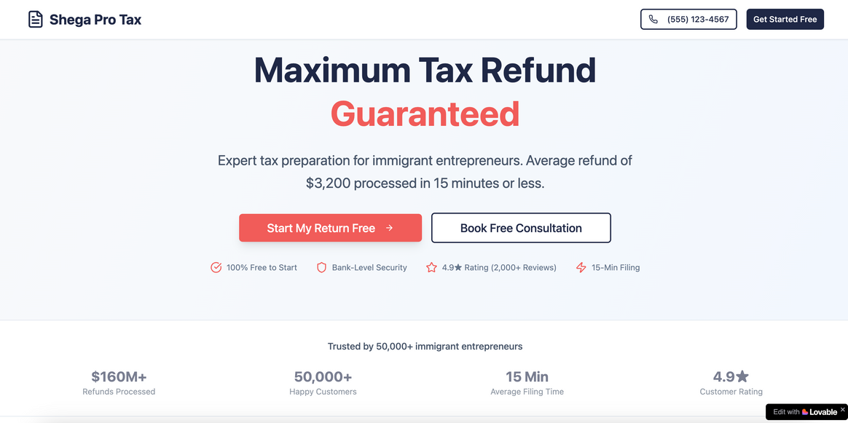
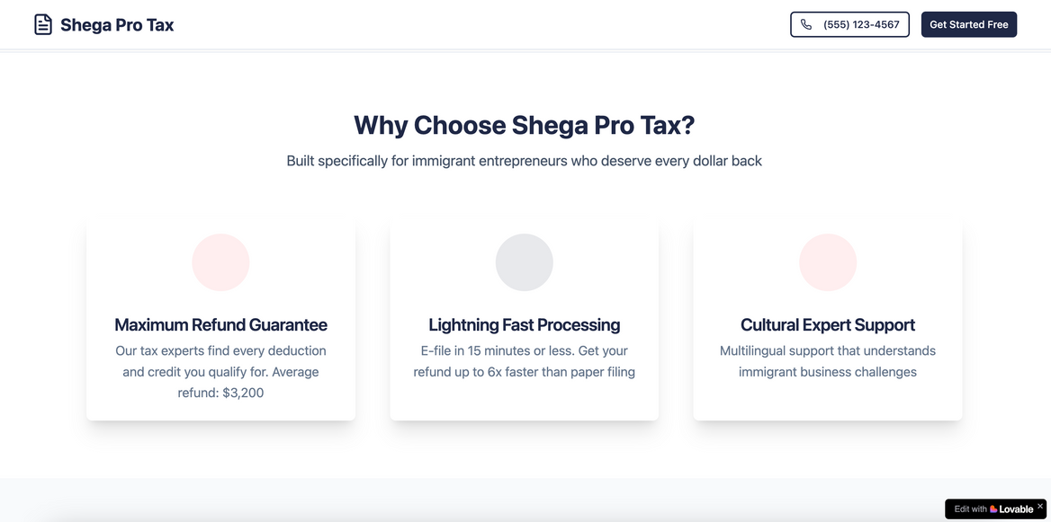
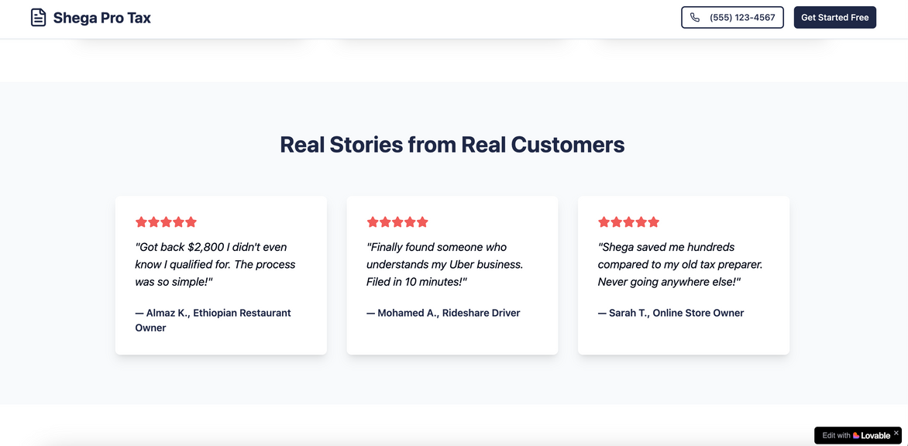
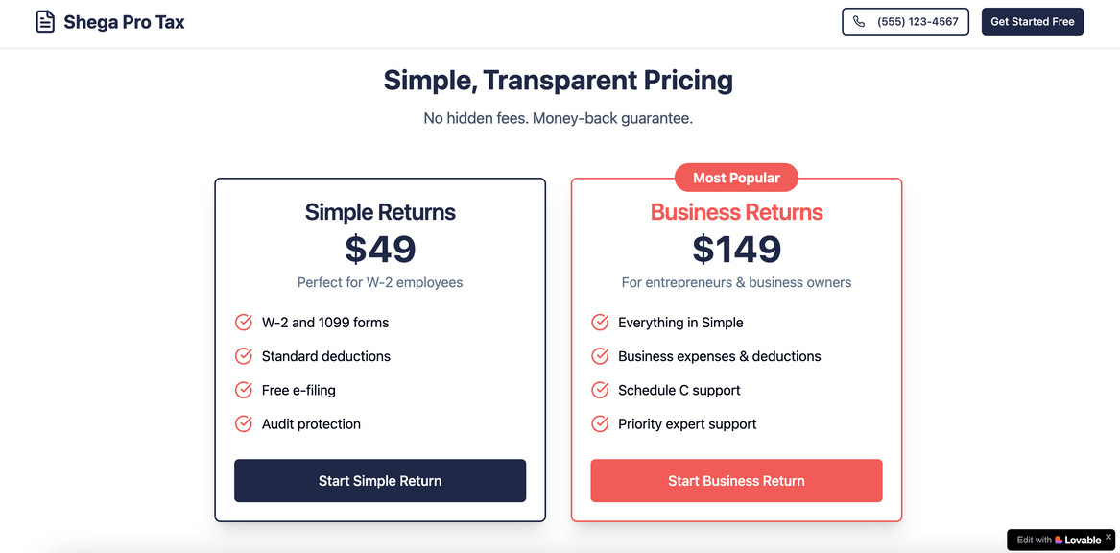
Brand Refresh
TACTIC 1

Slide 13








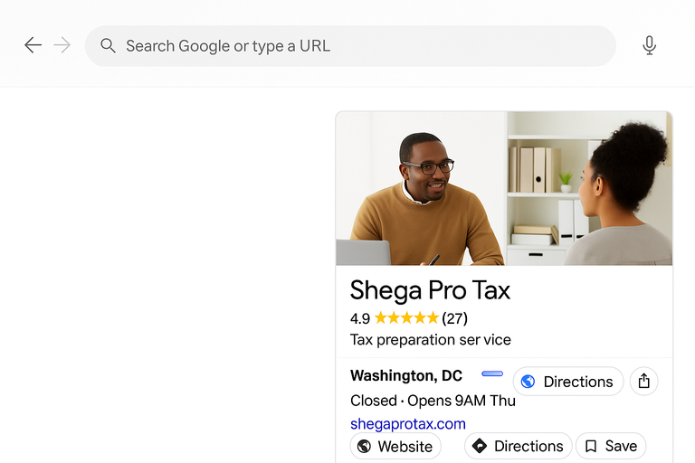
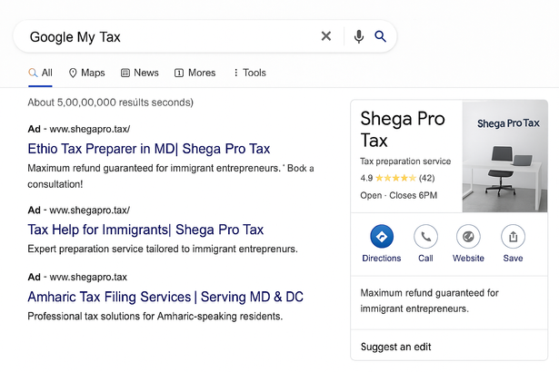


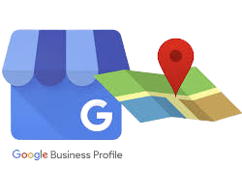




SEO
TACTIC 2
Increase organic traffic to the website
KEYWORDS OPTIMIZATION
ON-PAGE SEO OPTIMIZATION
LOCAL SEO WITH GMB
FIND WHAT LOCALS ARE SEARCHING FOR
WESBITE COMPONENTS TO BE KEYWORD FRIENDLY
CLAIM & VERIFY GMB PROFILE AS SHEGA PRO TAX
FOCUS ON LONG-TAIL KEYWORDS
LINK RELATED PAGES WITH ACHOR TEXT
LOCATION SPECIFIC REVIEWS

Slide 14

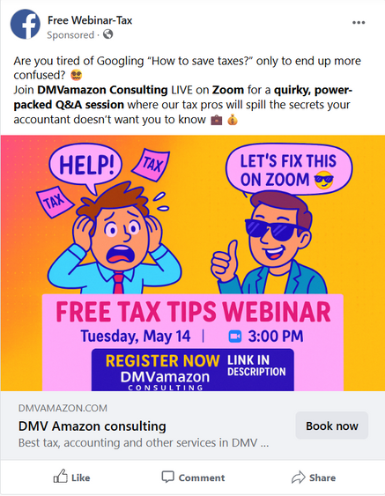
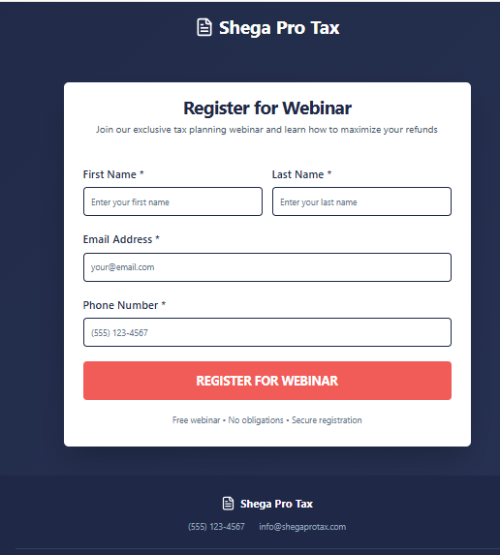
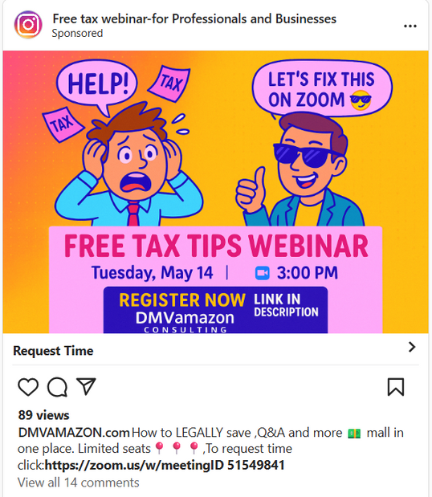
TACTIC 3
E-mail Marketing
01
Create Meta Ads to acquire new leads
02
Sign up for Webinar

Slide 15




TACTIC 3
E-mail Marketing
03
Customer Engagement Journey
04
Budgeting
SERVICE | PURPOSE | COST
Canva | Create visuals for campaigns and emails | Lifetime ($15/mo)
Hubspot | Manage contacts, automate workflows | Free basic CRM with pipelines; $30/mo
Google Analytics | Track website/email traffic and behavior | FREE
Welcome emails for new users;
post purchase email for existing users
Push reminder emails for
re-engagement
Step 1
Step 2
Send mails post purchase
Send confirmation emails
Step 3
Step 4

Slide 16



Sample emails
Welcome Email
Reminder Email
Post-purchase Email

Slide 17


Viral video campagin via
social media marketing
TACTIC 4
#TAXES vs EXES

Slide 18

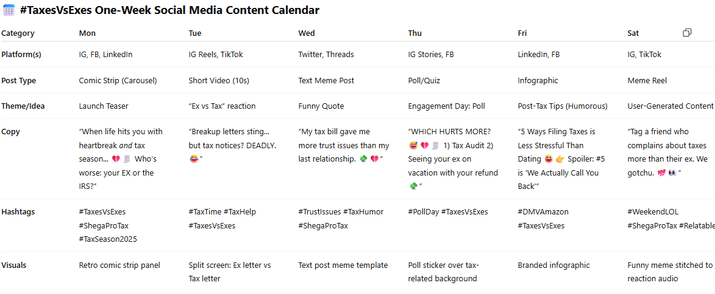
CONTENT CALENDAR

Slide 19




CONTENT STRATEGY ROADMAP
& BUDGET
PHASE 2 | Consideration & Conversion
Phase | Est. Cost
PHASE 1 | $50–$100 (domain & Canva Pro) Paid AD: $2500
PHASE 2 | $0–$30/month Paid AD: $1500
PHASE 3 | $50–$150 (ad spend, optional email tools) Paid AD: $1500
PHASE 1 | Foundation & Brand Awareness
Month 1–2
Phase 3 | Retention
Month 5–6

Slide 20
KPI AND MEASUREMENT
Objective
Analysis tool
1
1,000
+50%
Meta Business Suite
Google Analytics
SNS (IG, FB, Youtube) insight
Mailchimp
Google Forms
access for website visitor / for SNS followers within 3 month
2
100
+20%
new U35 clients in 6 month / for repeat customers over the next year
Tactics
Awareness
Consideration
Engagement
Retention
Overall business KPI
+40%
+20%
+50
≥4.5
Website
(SEO)
50%
/ month
/ month
/ month
/ month
+20%
Bounce ratio
SEO trafiic ratio
CVR
(Quote →Appointment)
appointment via web
/ month
Retuen vistor rate
Ave review score stars
in one years
+50%
+30
/ 3 month
/ month
+$50
Followers
Inquiry from customers
+20%
/ year
SNS
/ month
Customer Acquisition Cost
+15%
+1,000
referral based visits
/ month
/ month
Engagement ratio
content views
+30%
/ year
25%
10%
+20%
Revenue growth
Email
/ month
/ month
/ 6 month
Open ratio
CTR
Re-engage ratio for auto email
Notes:
To achieve our two objectives, we have defined KPI, as shown in the slide.
most importatn KPIs are
For website, we aim to increase the conversion ratio via appointment bookings by 20 % increase per month.
On social media, we target a 15% increase in engagement rate each month.
In email marketin, we are aiming for an open rate of 25% per month.
Furthermore, across all tactis, out goal is to improve customer retention by 20%.
These KPPI will be measured using five tools incluing Meta Business suite and Google analytics,
Also, we have defined overall business KPI
Like average review rating of 4.5 stars, customer acquision cost below $50 per year, and 30% annual revenue growth

Slide 21


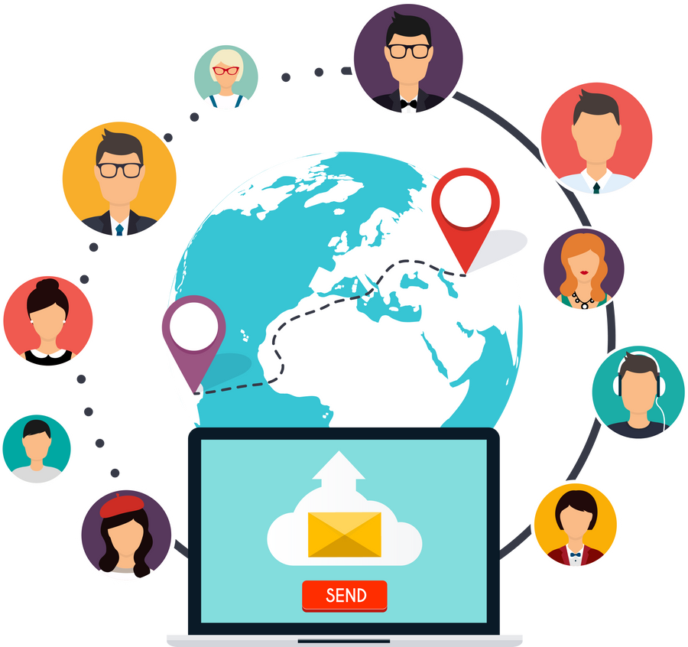


FINAL RECOMMENDATIONS TO CLIENT
Implement a Comprehensive Brand Refresh
Strengthen SEO and Local Search Visibility
Launch Email Marketing Campaigns
Execute a Viral Social Media Campaign
Launch Referral and Review Program
Notes:
Recommendations
First, implement a comprehensive brand refresh to improve the identity and user trust. Second, boost SEO and local search so more potential clients can easily find online. Third, launch email marketing campaigns to nurture and convert leads.
Fourth, Run a viral social media campaign to increase engagement and reach younger audience
And finally, create a referral and review program to build loyalty and attract new clients.
Thank you for listening our presentation.

Slide 22
THANK YOU!

Slide 23
REFERENCE
Mailchimp. (2024). Email marketing benchmarks and statistics by industry. https://mailchimp.com/resources/email-marketing-benchmarks/
WordPress. (n.d.). Site Kit by Google – Analytics, Search Console, AdSense, Speed. WordPress.org. https://wordpress.org/plugins/google-site-kit/

